Slide 1
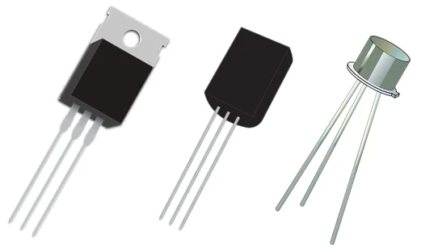
Transistors
and other announcements

Slide 2
What is a Transistor?
“A transistor is a semiconductor device used to amplify or switch electrical signals and power. It is one of the basic building blocks of modern electronics. It is composed of semiconductor material, usually with at least three terminals for connection to an electronic circuit.”
Wikipedia states that:
So what does it actually do?
Notes:
https://en.wikipedia.org/wiki/Transistor#:~:text=A%20transistor%20is%20a%20semiconductor,connection%20to%20an%20electronic%20circuit.

Slide 3
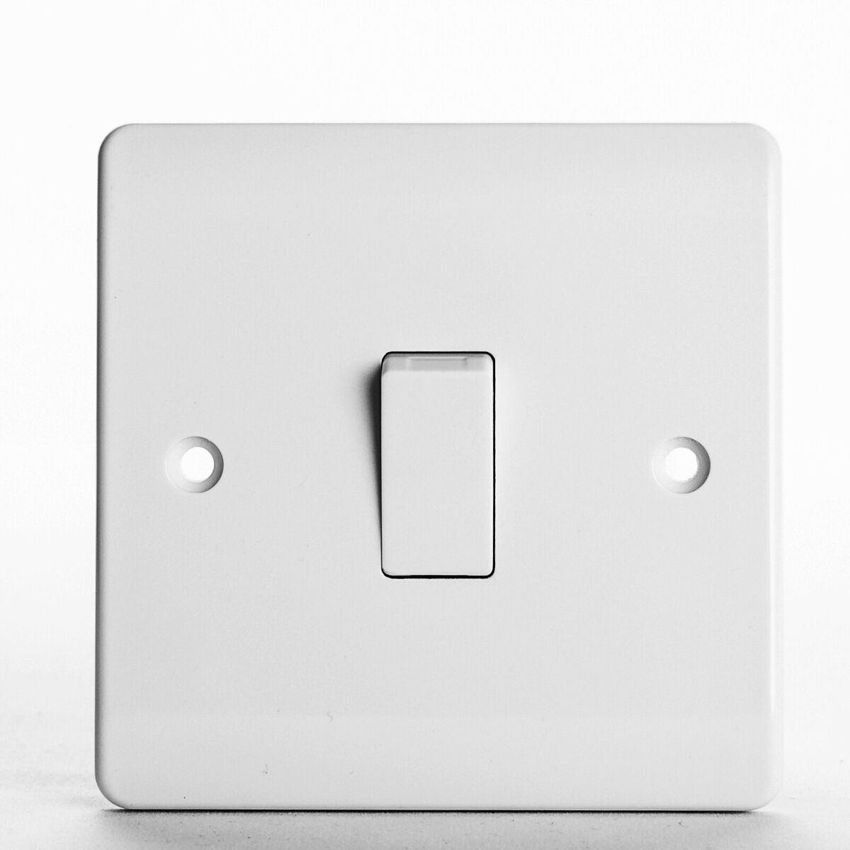
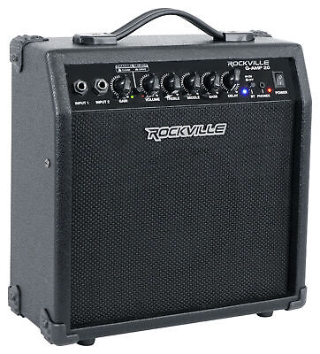
What does a Transistor do?
Transistors act with two main functions:
Switch: can turn a current on or off
Amplifier: can take a small electrical signal and make it stronger

Slide 4
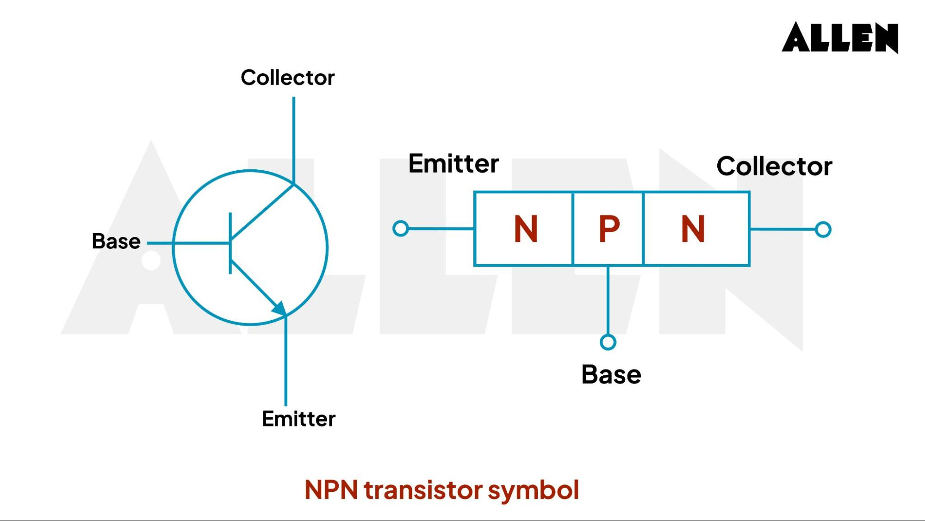
Transistor Pins

Slide 5
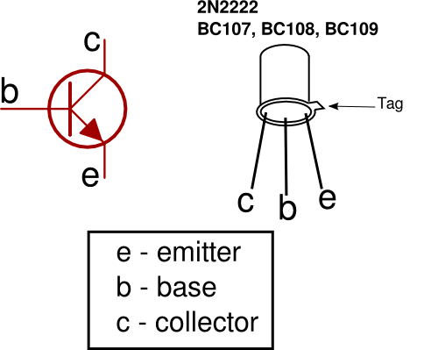
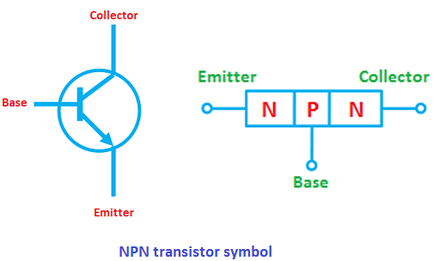
Transistor Pins

Slide 6
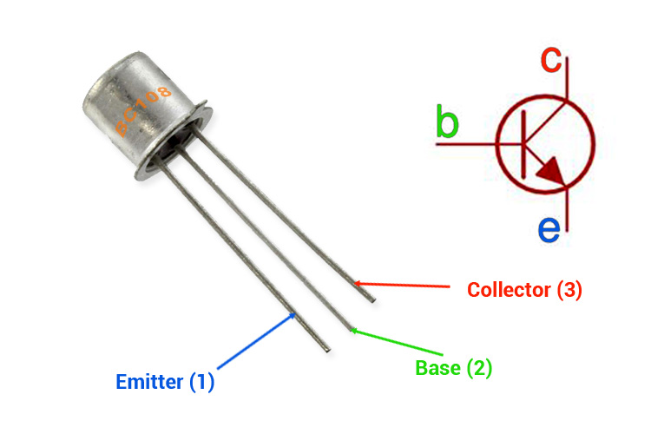
Transistor Pins

Slide 7
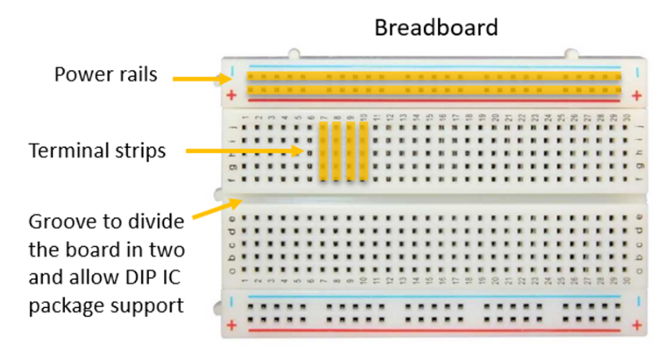
Reminder…

Slide 8
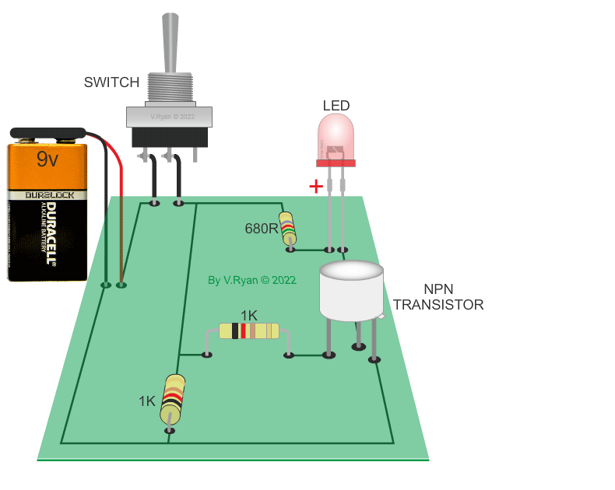
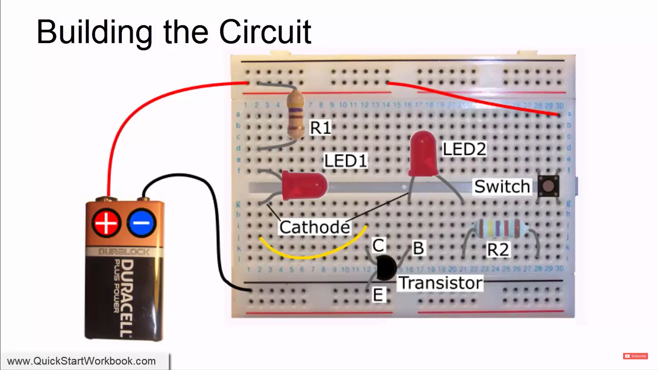
Using Transistors

Slide 11
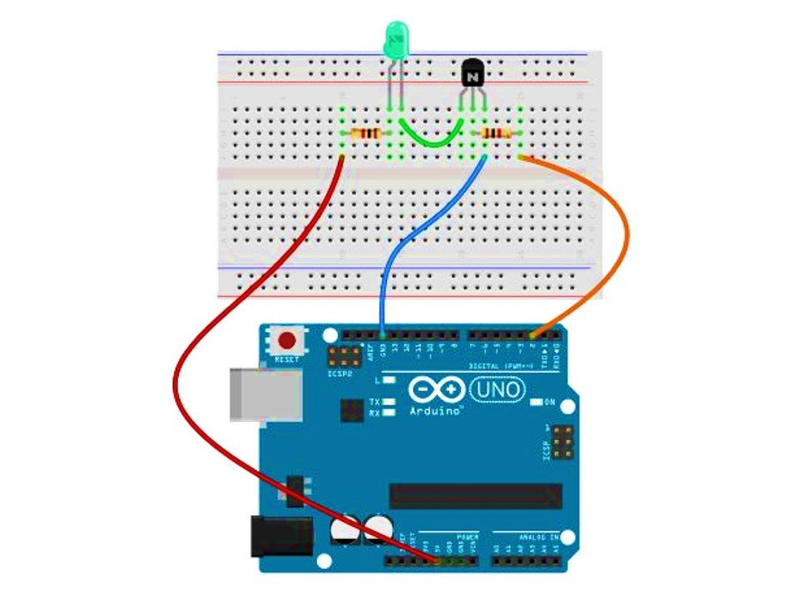
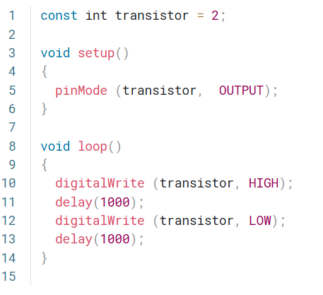
Using Transistors – With Code
Notes:
https://projecthub.arduino.cc/SBR/switching-using-transistor-18cb61

